Slide 1
Forest
HOME
FAHB
Joy
FAHB
ABOUT US
Visit Us
Projects
Our story
Galleries

Slide 2

ABOUT US VISIT US PROJECTS
LOGO
3 pictures showcasing the view of forest (carousel)
#FAF1E4
#CEDEBD
#9EB384
#435334

Slide 3
ABOUT US VISIT US PROJECTS
LOGO
3 pictures showcasing the view of forest (carousel)
#FAF1E4
#CEDEBD
#9EB384
#435334

Slide 4
ABOUT US VISIT US PROJECTS
LOGO
3 pictures showcasing the view of forest (carousel)
#FAF1E4
#CEDEBD
#9EB384
#435334

Slide 5
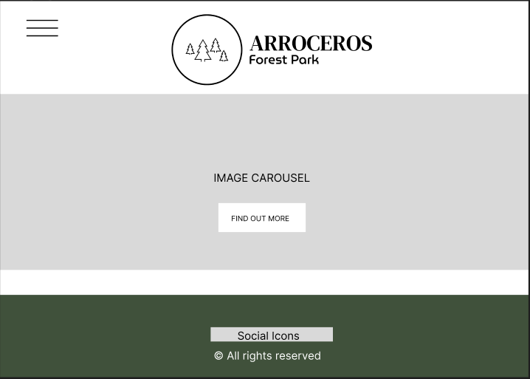
#FAF1E4
#CEDEBD
#9EB384
#435334

Slide 6
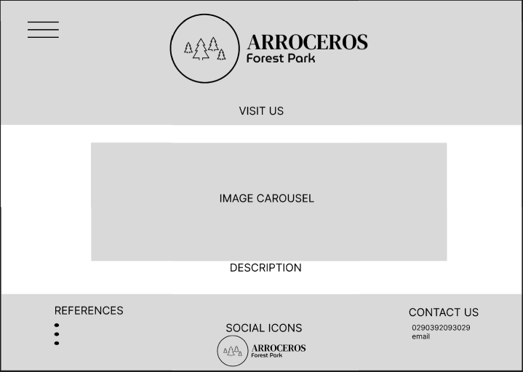
#FAF1E4
#CEDEBD
#9EB384
#435334

Slide 7
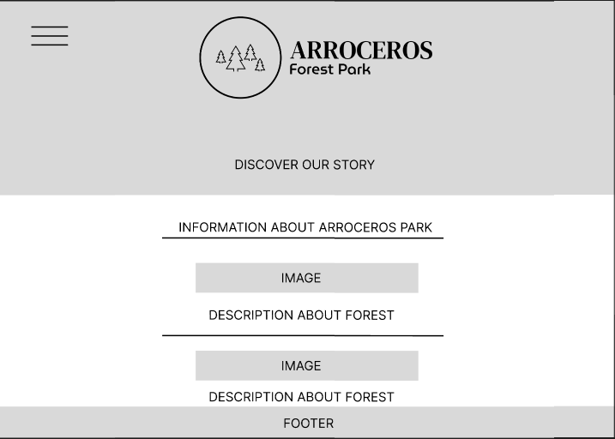
#FAF1E4
#CEDEBD
#9EB384
#435334

